Slide 1


Slide 2
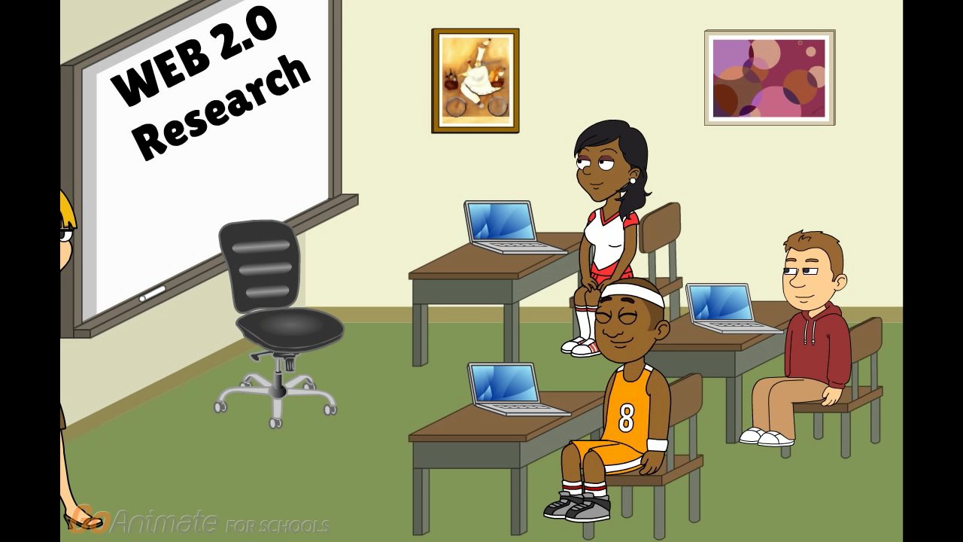
They Can’t Wait for Go Animate
Kimberly Moore
All Saints’ Episcopal School, Fort Worth
Head Librarian/Web 2.0 Research Teacher
Notes:
http://kimberlymoorelibrarian.weebly.com/
@kimthelibrarian

Slide 3
Digital Storytelling increases multiple literacies
• Research Skills: Documenting the story, finding and analyzing pertinent
information
• Writing Skills: Formulating a point of view and developing a script
• Organization Skills: Managing the scope of the project, the materials used and
the time it takes to complete the task
• Technology Skills: learning to use a variety of tools, microphones and multimedia authoring software
• Presentation Skills: Deciding how to best present the story to an audience
• Interpersonal Skills: Working within a group and determining individual roles
for group members
• Problem-Solving Skills: Learning to make decisions and overcome obstacles at
all stages of the project, from inception to completion
• Assessment Skills: Gaining expertise critiquing their own and others’ work
Notes:
Thank you to the Mrs. Moore avatar and my avatar class! Yes, digital storytelling is an excellent way to engage student imagination while learning multiple literacies at the same time. Students learn to express emotion using video, pictures, and sound while building skills in research, writing, organization, technology, presentation, interpersonal, problem-solving, and assessment.
SOURCE: http://digitalliteracyintheclassroom.pbworks.com/f/Educ-Uses-DS.pdf

Slide 4


Educator version of Go Animate costs very little and allows management of student accounts and videos
Easy to use themes along with complete animation suite
Create custom characters or use dozens of stock characters
Record your own voice or use text-to-speech character voices
Easy to embed or export to LMS or youtube
Lots of online tutorials
Don’t be afraid to learn along with your students. It’s time to teach transparently!
Notes:
I have used several online storytelling tools but the best by far is Go Animate. With the inexpensive educational version of Go Animate, students can create animated stories that are as fun to make as they are to watch. While there is a bit of a learning curve, my Web Research class’ favorite tool by a landside is Go Animate.
GO ANIMATE FOR SCHOOLS https://goanimate4schools.com

Slide 5
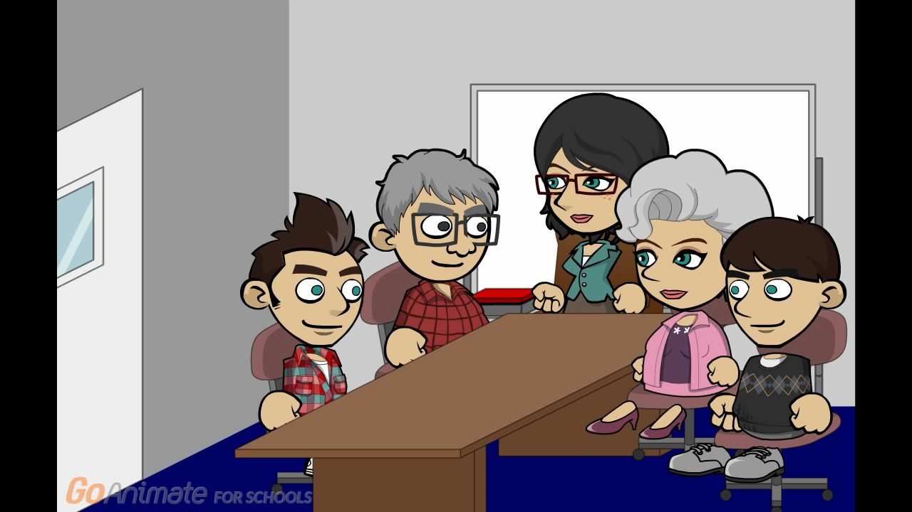
Student Go Animate examples
Gender Equality

Slide 6
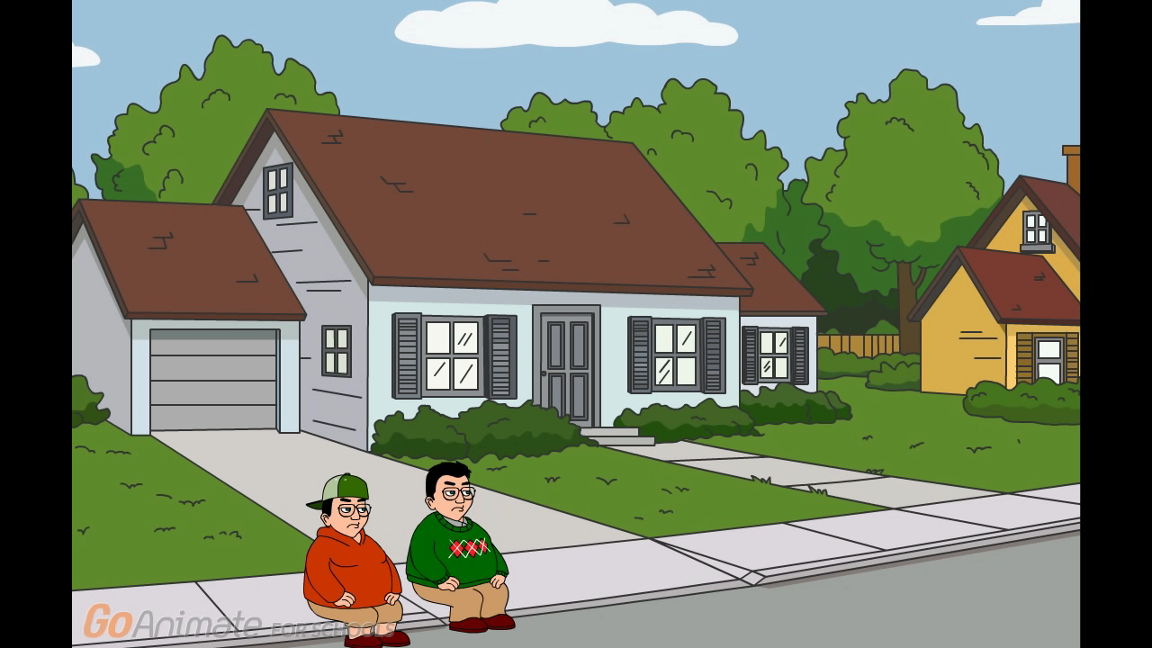
Mythical Creatures

