Slide 2
9 Web Tools in 5 Kimberly Moore All Saints’ Episcopal School, Fort Worth Head Librarian/Web 2.0 Research Teacher
@kimthelibrarian
Notes:
Six years ago, school administrators asked if I, the school Librarian, wanted to teach a required sophomore level course on web and research skills. I said, “Sure! Sign me up!” So, since I opened my big mouth and said YES, I had one summer to get prepped for fall classes. What should I include? How would I structure the class? I had to find the answers quickly! Just like how fast I need to talk right now.

Slide 3
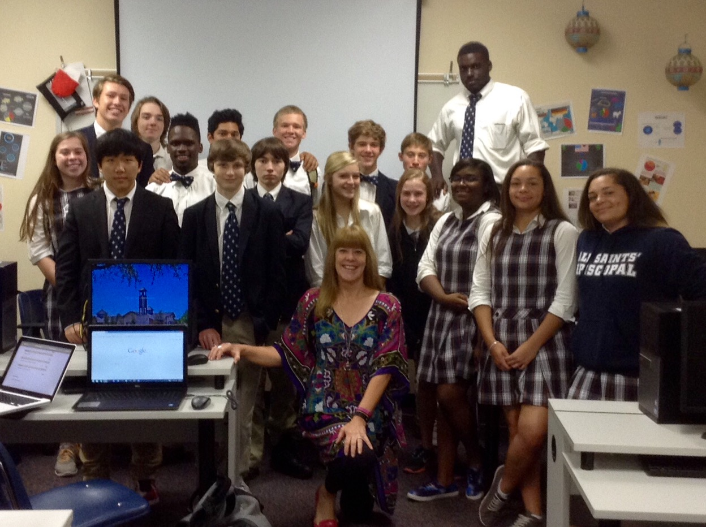
Web 2.0: Interactive Technologies and Research
Notes:
I wanted to teach online research skills in a way that was fun but educational and had meaning to my students. I decided to have students build a website on a topic of their own choosing filling it with research and products they created. I think it is very important that they choose the topic they research so they have a vested interest. This photo is of one of my spring classes this last year in my classroom, which is also a computer lab in the Library.

Slide 4
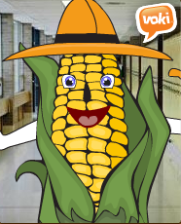
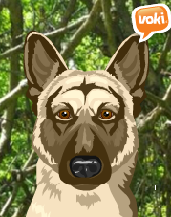
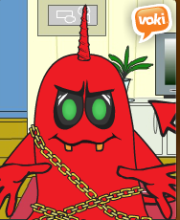
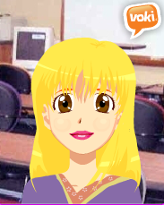
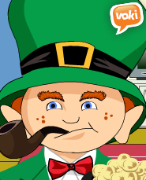
Presentation: Voki
Notes:
The first day of class I ask students to create a Voki avatar of themselves that gives some basic information about their lives as well as the random question of “If they were a super hero what super power would they want to have?” These avatars can look like anything at all, the sky is the limit. The one in the middle is me giving students the instructions for their own voki. They listen more quietly to my avatar than to the live me!

Slide 5
Brainstorm:
Notes:
Then students use Mindomo as a brainstorming tool to determine what they already know about their topic and what they want to learn about their topic. Mindomo allows you to include links, photos, and even videos into a familiar looking brainstorm map.

Slide 6
Notes:
You can choose the colors and structure of your mindmap from pre-set options in Mindomo. These are easily embedded into the students websites. By the way, all of my graphics are from student work.

Slide 7
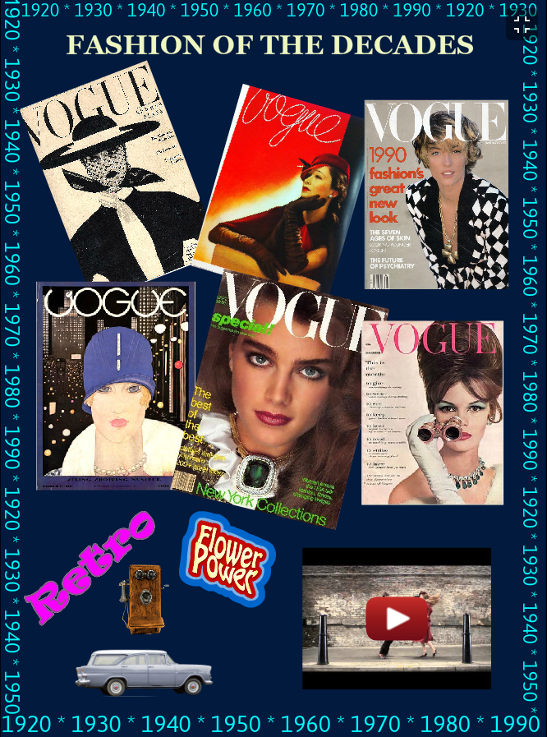
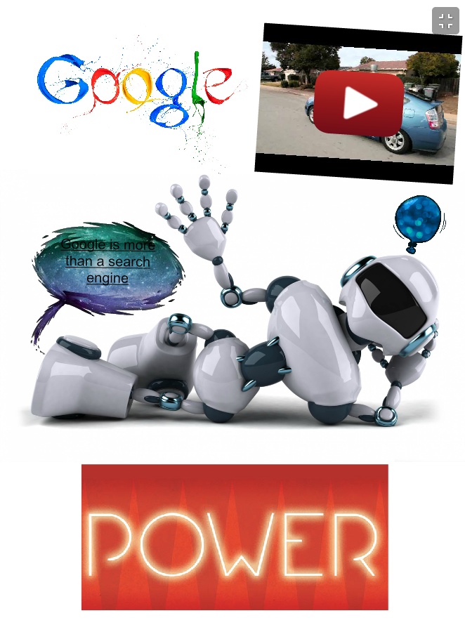
Presentation:
Notes:
The first major project my students create is a digital poster using Glogster which they also present to the class. This is the first time their peers have seen their websites and one of their products so they work hard to create an interesting digital poster.

Slide 8
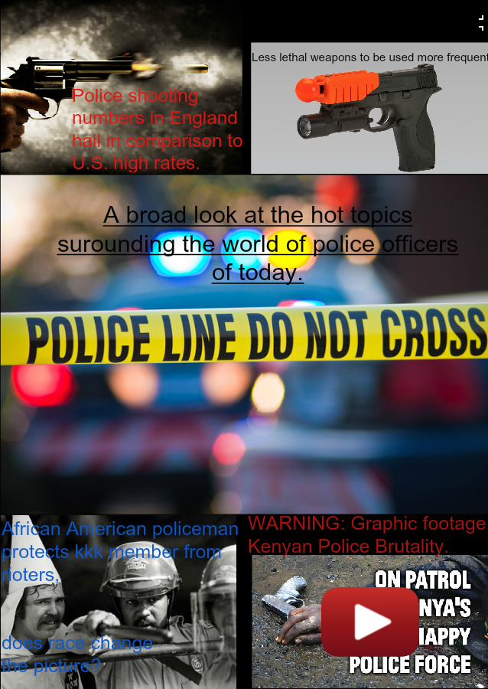
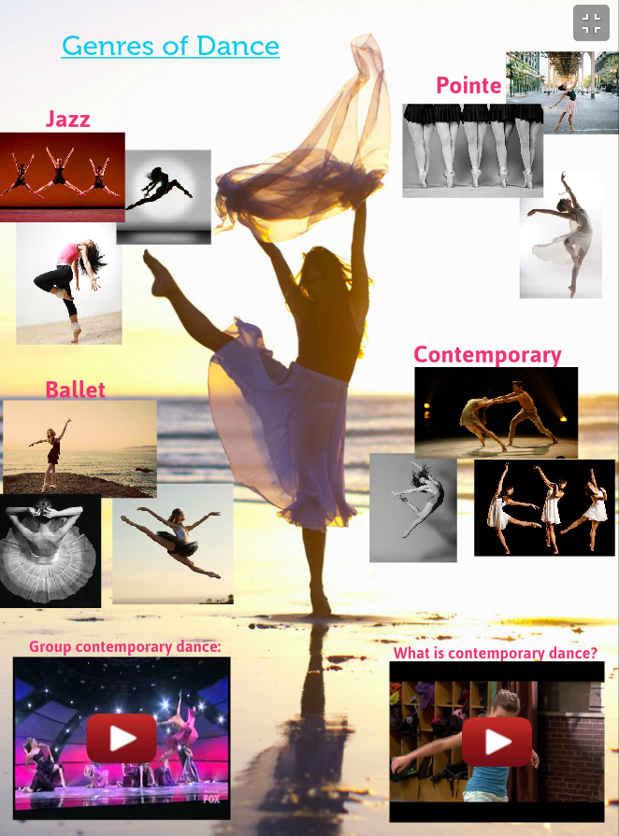
Notes:
Glogster can embed links, pictures, videos and has a vast array of simple to somewhat busy backgrounds for their glogs. They also have a multitude of realistic and animated clip art to include in posters. It is very easy for students to present their work to the class using glogster as their platform.

Slide 9
Presentation:
Notes:
Every semester I evaluate what I include in class. This last semester I decided to go with emaze as another presentation tool instead of my usual prezi.I felt that students know all about prezi so I wanted to teach them something new. Emaze has many appealing templates including a lot of 3D options which students love.

Slide 10
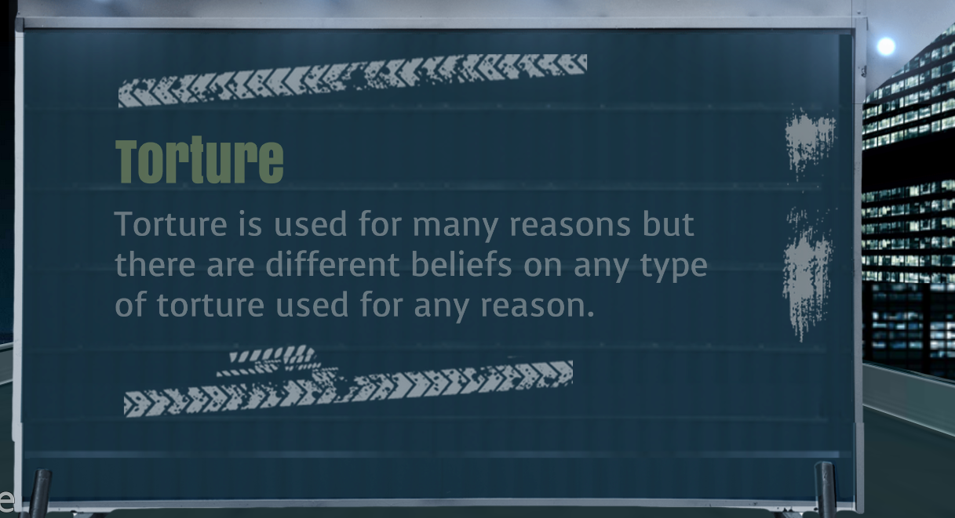
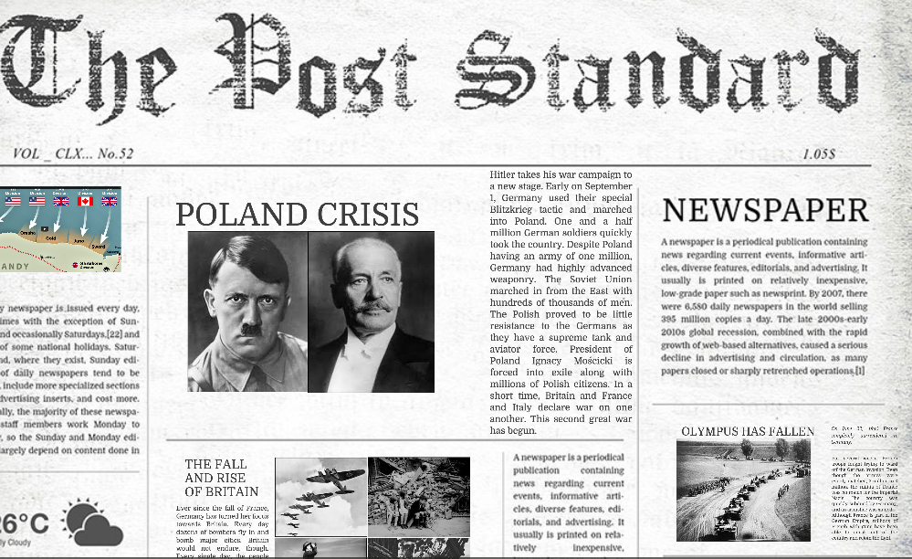
Notes:
Students told me that emaze was much easier to learn than prezi and they were very happy with their final products. Students also present these to class. I feel that this is an important part of my class, for students to learn to talk in front of their peers and teachers in a safe environment on a topic they care about.

Slide 11
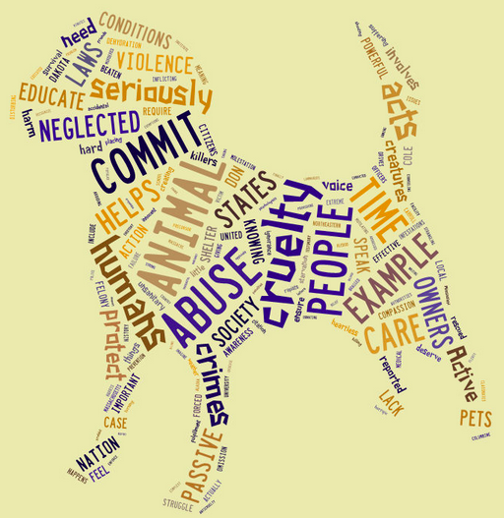
Visual:
Notes:
Tagxedo is a great word cloud generator. My students use a short essay on their topic to create a word cloud. I discuss what word clouds can convey by sharing presidential speeches in word clouds to show what was important during that time period. Word clouds are a great way to show the most important points in a speech, paper, lecture or any other platform.

Slide 12
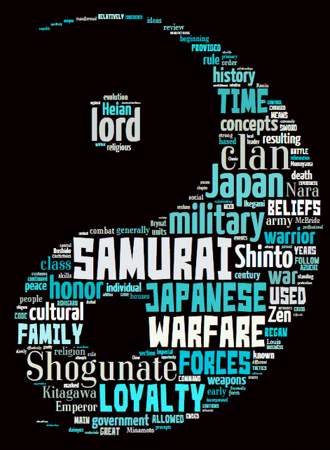
Notes:
What makes tagxedo more appealing than other word cloud generators is the ability to create the word cloud into many optional shapes, colors, and fonts. Students are proud of their final product when they discover a template shape that perfectly conveys their chosen topic.

Slide 13
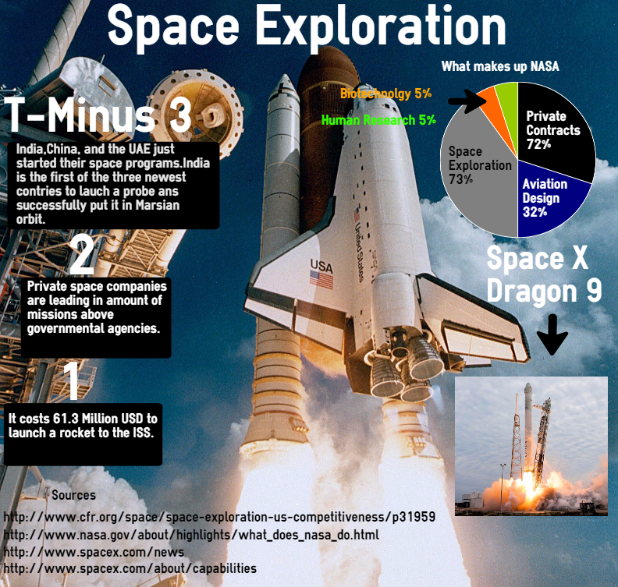
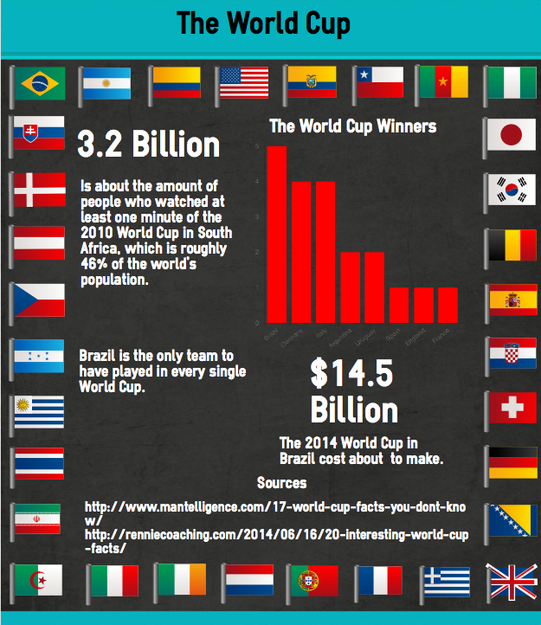
Visual:
Notes:
New on my plate is infographics. I kept seeing infographics everywhere in social media and advertising so I thought this would be an excellent web tool to learn. There are many options to make free infographics including piktochart, canva, infogr.am, and even in Powerpoint.

Slide 14
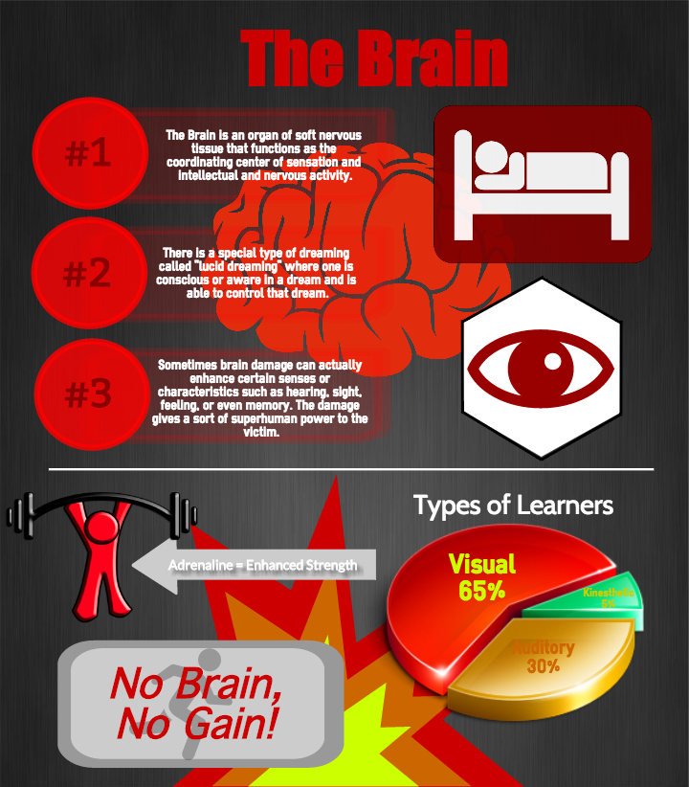
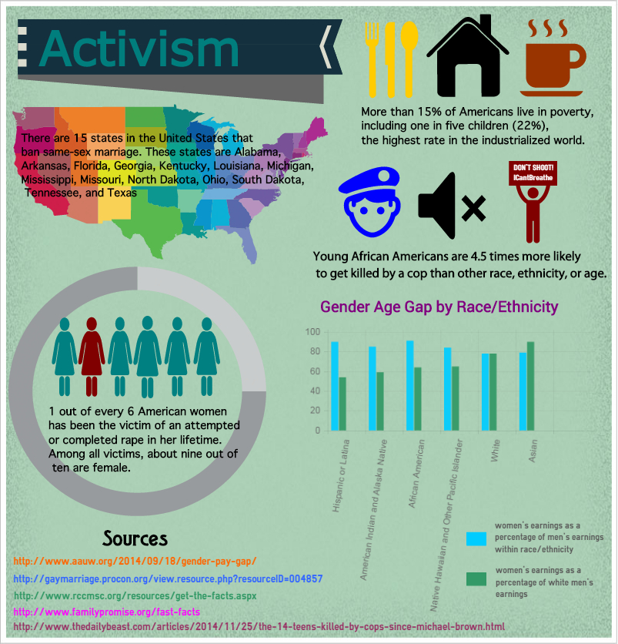
Notes:
After making my own infographics in several of these, I chose easel.ly as the easiest to use and also because it has the most free templates and graphics. My students love the creativity of an infographic. I require 3 facts and 2 sources, as well as a chart or graph in my students’ final product.

Slide 15
Storytelling:
Notes:
Storytelling couldn’t be easier by using the free web tool Animoto. Animoto will give teachers a free educational version along with free accounts for your students. My students create a one-minute “commercial” on their topic.

Slide 16
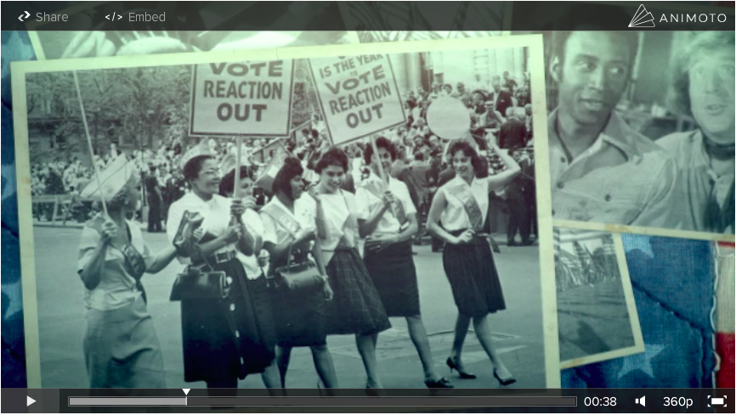
Notes:
It has multiple video templates, songs, graphics, and even video but still allows for personalization of the final video. You can include your own photos and music and even manipulate the timing of the final video. I also teach students about Fair Use of Copyright Laws and they include a copyright disclaimer in their video as well as cite any music they upload.

Slide 17
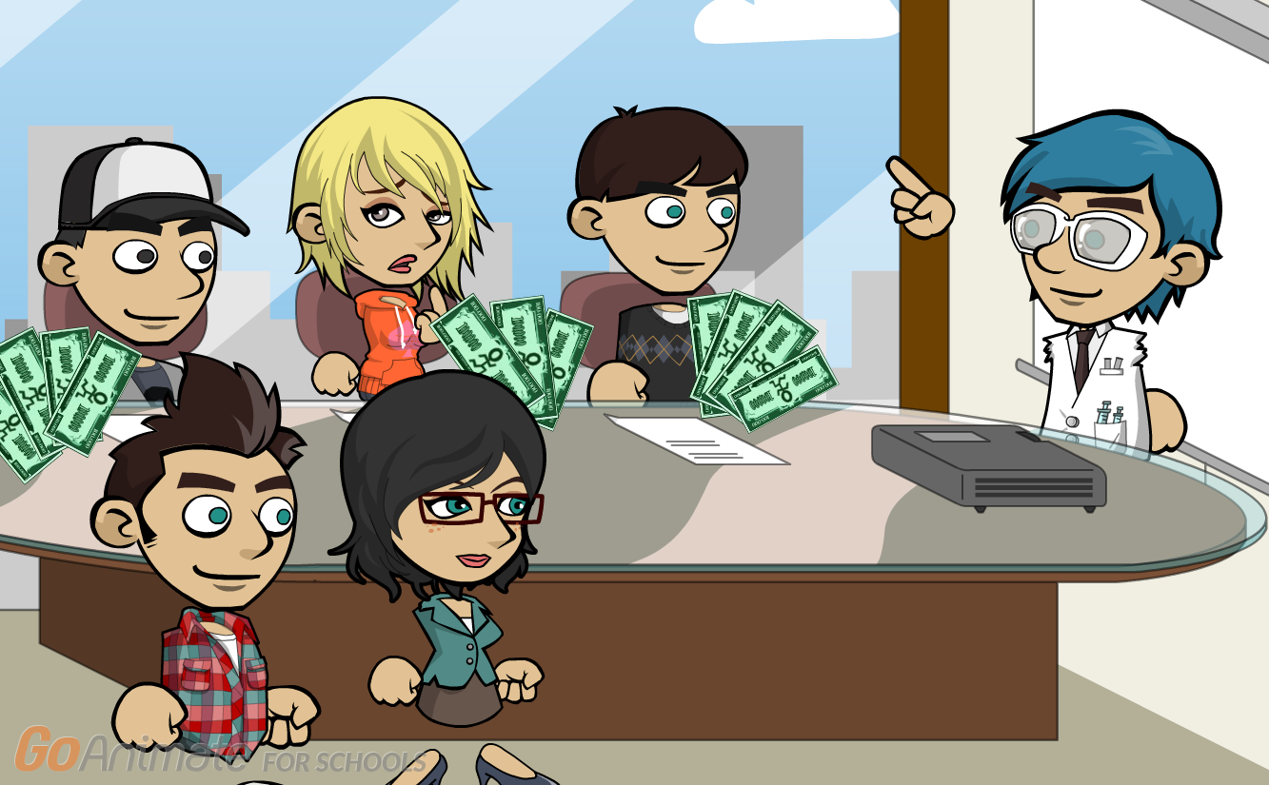
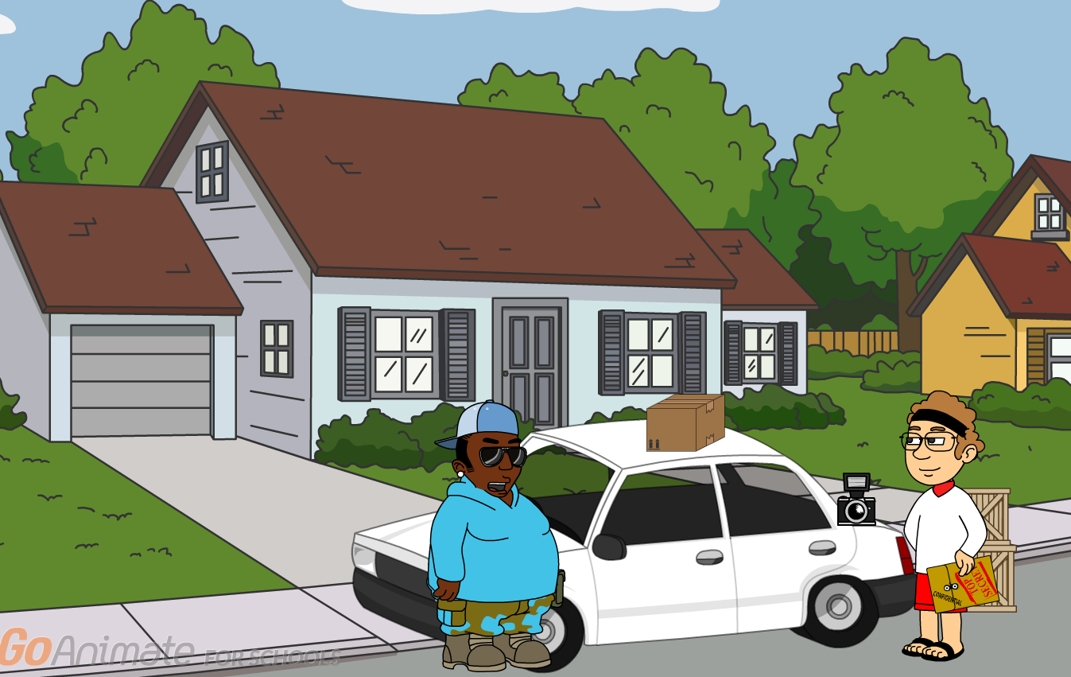
Storytelling:
Notes:
But for storytelling you cannot beat Go Animate! My students literally cannot wait to use this animation tool. It is the final product we create in Web class. I actually pay a small fee for the educational version of Go Animate so students can create longer videos and access all components in the creation of their videos. The requirement for this assignment is simply to tell a story on their topic in their animation.

Slide 18
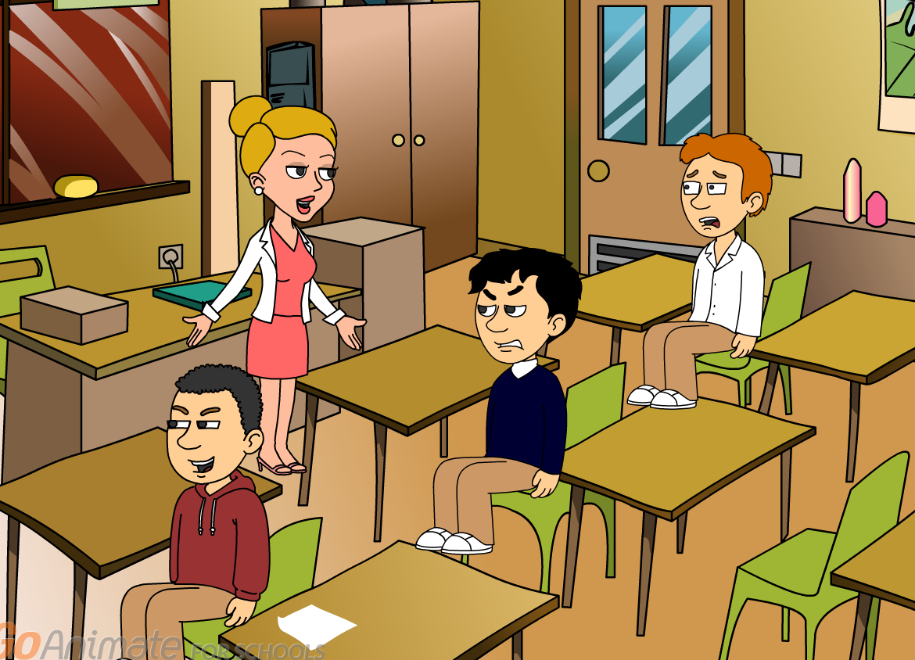
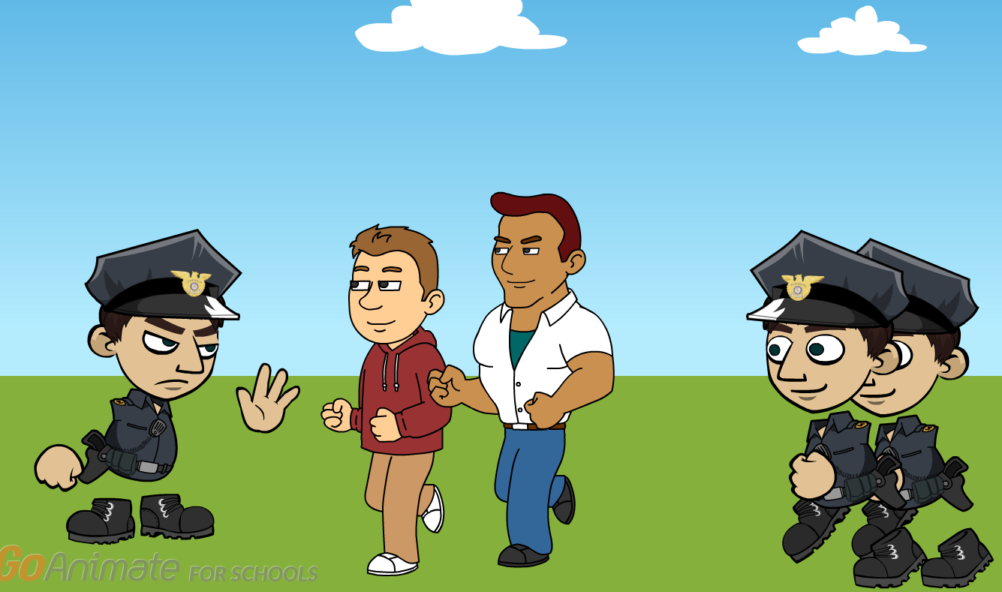
Notes:
Go Animate takes a bit longer to learn and teach so make sure to give yourself time. And please don’t be afraid to just jump in with both feet like I did the first time I taught Go Animate. I was transparent with my students and told them I didn’t know everything about using the tool and asked them to share with me anything they figured out. I love learning from my students and they love being “experts” .

Slide 19
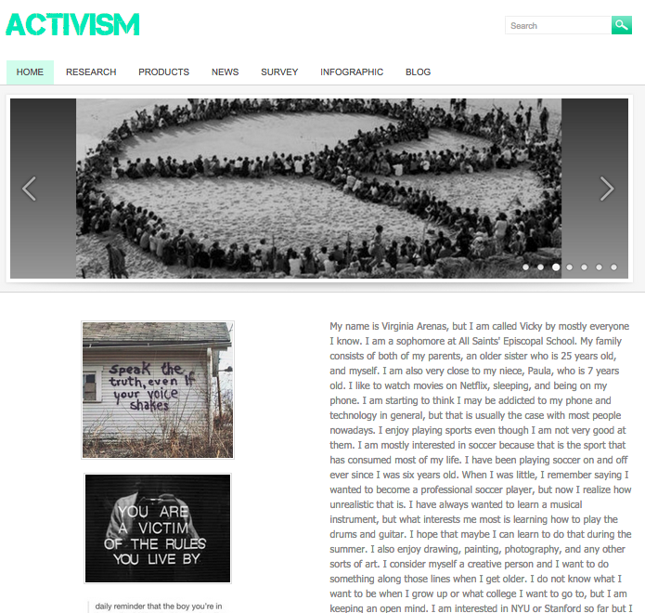
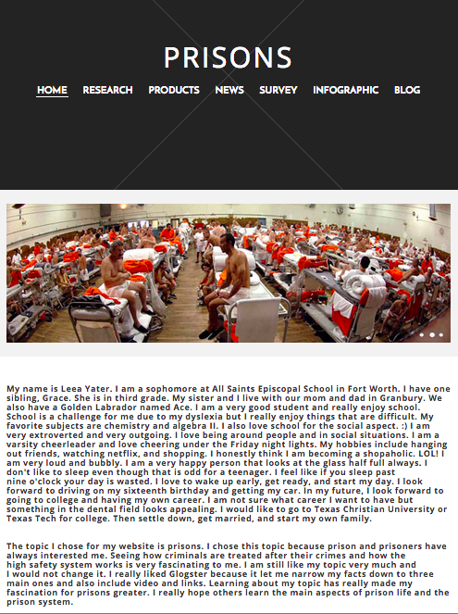
Digital Portfolio:
Notes:
When I started this class I had to find a safe (password protected) platform to house all the research and products my Web students created. When I found Weebly, I knew found the perfect solution to my students digital portfolio. Weebly costs only $1.00 per student and includes all components of weebly.

Slide 20
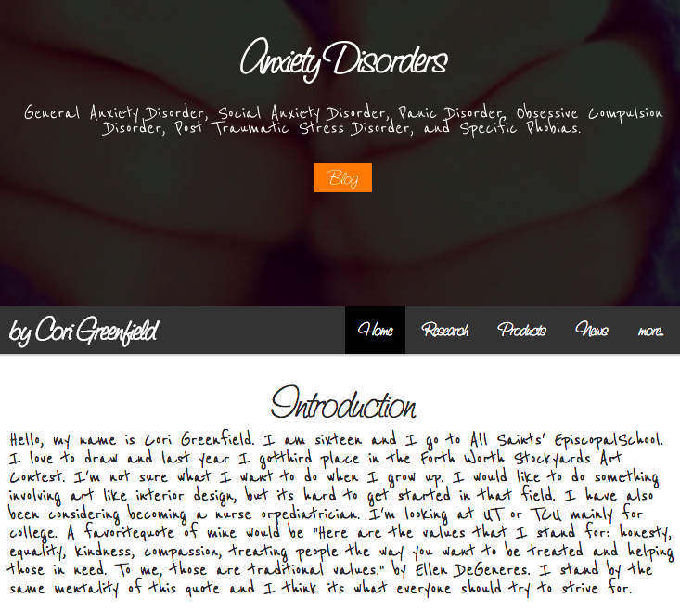
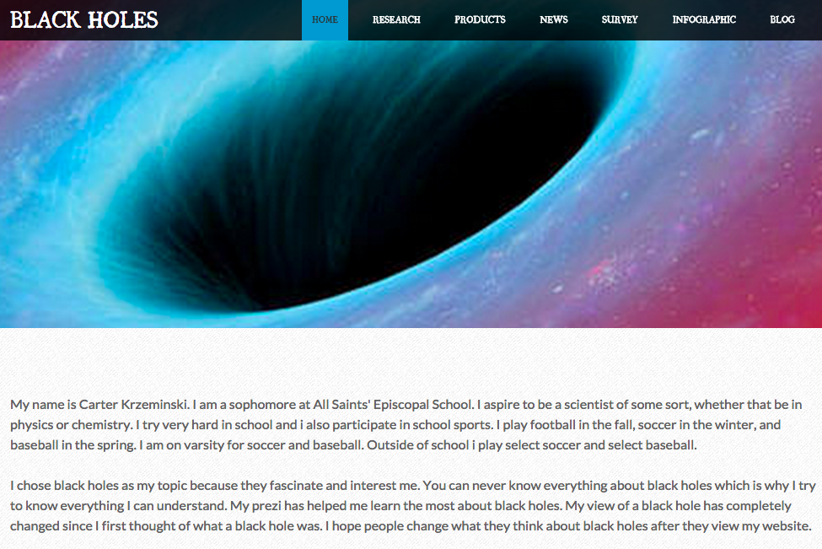
Notes:
My students love that their website doesn’t look anything like their peers website. They can completely personalize their website and create a final product they are proud of. And the addition of password protection allows them to include exactly what they want on in their digital portfolio.

Slide 21
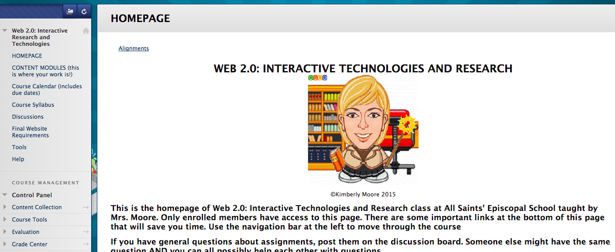
#10 Bonus!
Notes:
I know this presentation is titled 9 Web Tools in 5 but I have a “Librarian 9” that includes one more Web 2.0 tool! The Learning Management System (LMS) I chose to create my class online is the free version of Blackboard called Coursesites. Since I was familiar with Blackboard using it as faculty adjunct at University of North Texas, it was an easy choice. I highly recommend Coursesites as it is easy to navigate and create courses.
Thank you so much for your time and I hope you take away at least one Web 2.0 tool to use with your students next year.
For access to my entire Web 2.0 course go to https://www.coursesites.com/s/_ASESWeb2.0 (login with username: allsaints and PW: saints)
For my professional website: kimberlymoorelibrarian.weebly.com/
CONTACT INFO:
kimrmoore@sbcglobal.net
kimmoore@aseschool.org
Twitter @kimthelibrarian

